Slide 1

What Makes The Housing Market “Hot”?
Emily Phillips

Slide 2

Introduction
Since the end of 2020, home prices have been on an uphill trend, along with the demand for houses.
Housing markets throughout the United States have gained traction and some have become known as being “hot” for their popularity amongst home buyers
We want to know what makes those markets hot!

Slide 3
Business Questions
Which regions of the United States have the hottest housing markets?
Is there a cutoff for the market hotness index where a significant difference between markets becomes apparent?
Does the allure of the certain cities (favorable place to live) play into the cities’ assigned market hotness index?
How has time (months, years) impacted the hotness of metropolitan areas?
Can we predict the market hotness index based on various factors?

Slide 4



Data Explanation
Two datasets:
Historical monthly data for metropolitan market trends and statistics on active listings
2. Historical Hotness Market Index data for metropolitan areas
“Metropolitan statistical area” – Data on 384 metropolitan statistical areas of the United States – pulled from the United States Census Bureau
2020 population counts
2021 population estimates
Target Variable: Hotness Rank from 1-300
Realtor.com Logo
Wiki Logo
Notes:
The various measures included: the population as of July 1, 2021 as estimated by the United States Census Bureau; the population as of April 1, 2020 as enumerated by the United States Census Bureau, and the percent change in population from April 1, 2020 to July 1, 2021.
The target variable for modeling was Hotness Rank, which is “the specified zip code, county, or metro area’s Hotness rank, by Hotness score, compared to all other zip codes, counties and metro areas. A rank value of 1 is considered the hottest” (Conner et al., n.d.).

Slide 5
Methods
Checking For Duplicates
Sub-setting Datasets
No duplicates were found in any of the three datasets
Focused on years 2020 & 2021 and only allowed for quality records from Realtor.com
Data Type Conversion
Handling Missing Data
Ensured that variable types correctly corresponded with variable values
Removed any row with missing data to ensure data integrity and independence among metro areas
Merging Datasets
Once individual datasets were cleansed, they were merged to get market data and population date in one place

Slide 6


Analysis

Slide 7

Main Takeaways
Denser, highly-populated metropolitan areas do not tend to be as “hot” as areas with lower population counts in 2020
California & the Midwest have the highest concentration of hotly-ranked metropolitan housing areas in 2020
Hotness ranking increases and decreases per metropolitan area from year to year → even the hotter areas get colder over time
The hotness rank target variable was very unreliable for predictive modeling (300 classes)

Slide 8
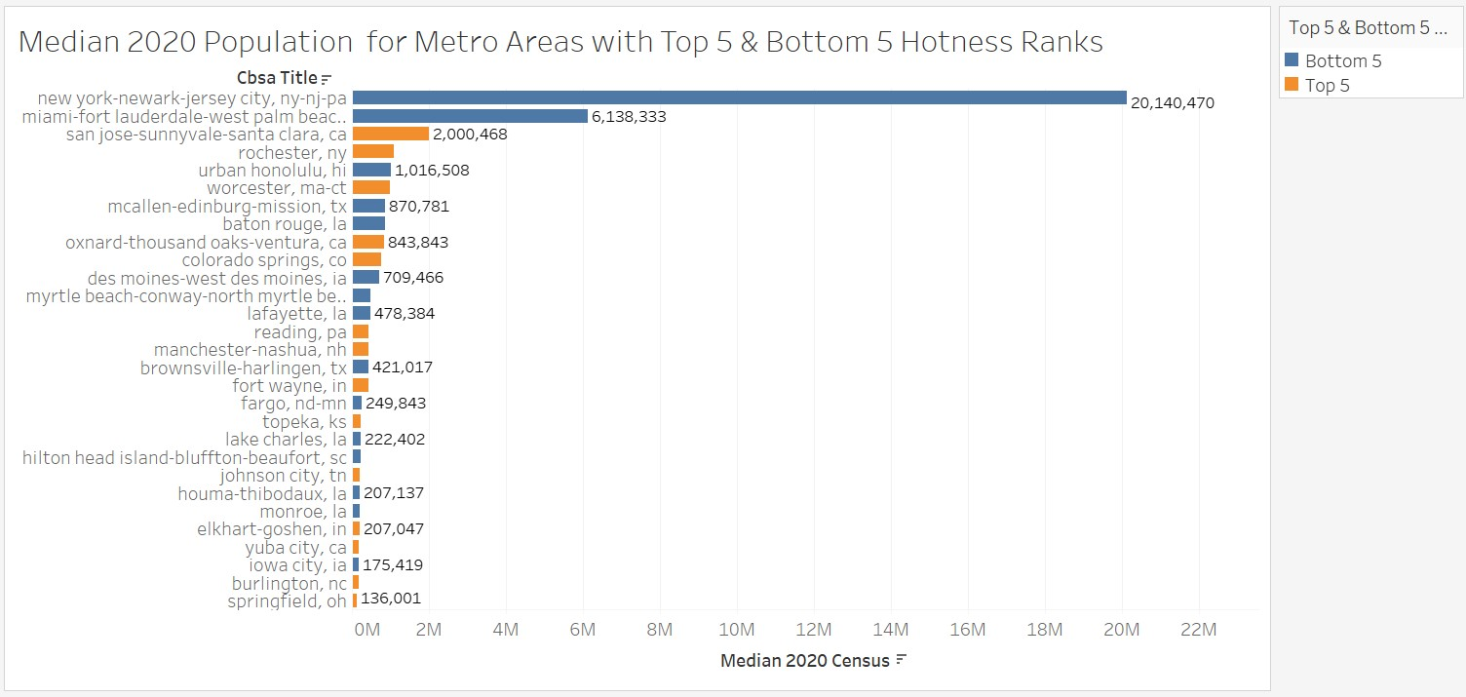

Slide 9
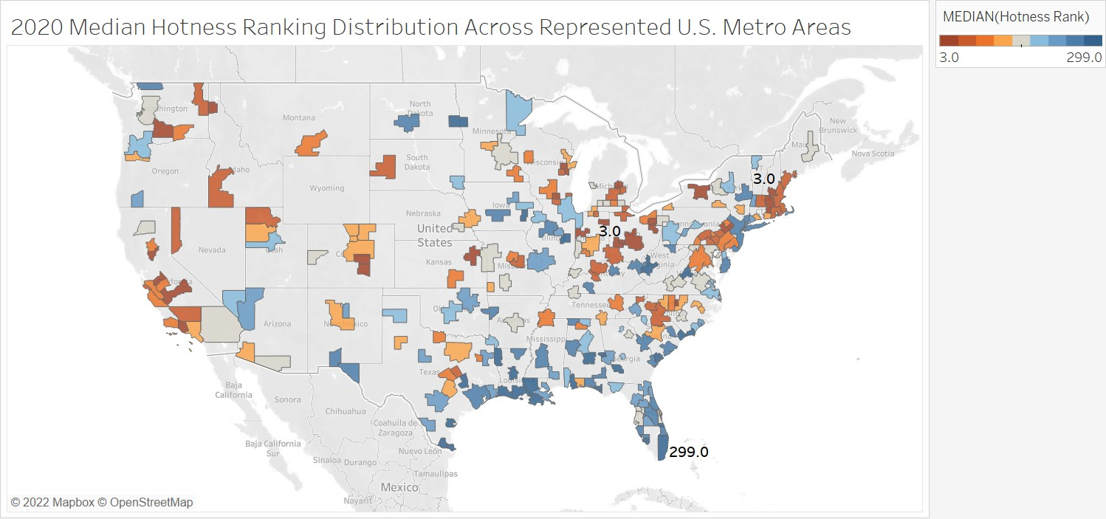

Slide 10
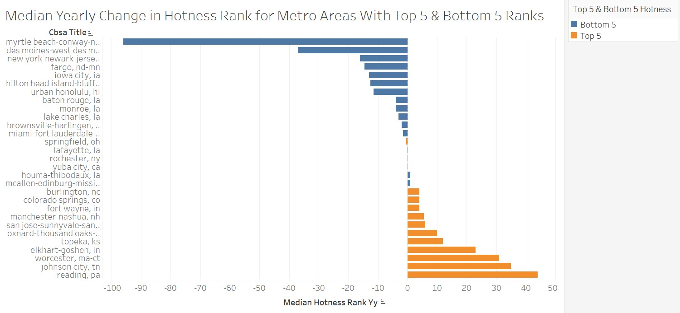
Notes:
positive value indicates that the geography’s Hotness has decreased (moved down in ranking), and a negative value indicates that its Hotness has increased (moved up in ranking).

Slide 11

Risks & Rewards
Risks
Rewards
Predictive modelling piece needs more work and attention for proper classification
Not enough data on “livability” of metro areas
Potential for ethical issues
Useful knowledge for home buyers, home sellers, real estate agents, etc.
Benefits the companies & businesses nearby hot metropolitan areas
Stay ahead of the housing market

Slide 12
Thank you

